Slide 1


Weather Phenomenon and Fire Outbreaks
DSC 530 Data Exploration and Analysis
Gabriel Valenzuela

Slide 2
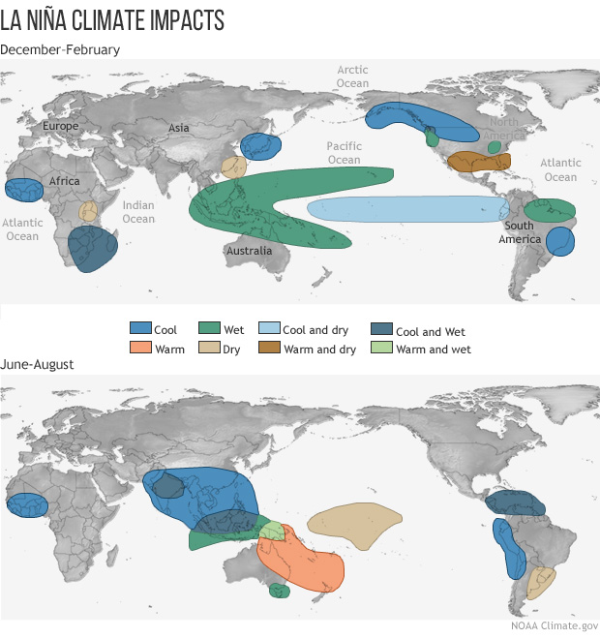
Statistical Question / Hypothesis
The weather phenomenon known as La Nina that occurs in the Pacific Ocean will cause more fire outbreaks in the Amazon due to the wind direction causing a dryer season in the area

Slide 3
Variables within Analysis
def_area_2004_2019.csv
PA
AMZ LEGAL
el_nino_la_nina_1999_2019.csv
Start year
End year
Severity
inpe_brazilian_amazon_fires_1999_2019.csv
Year
Fire spots
Latitude
Longitude

Slide 4

Description of Variables
def_area_2004_2019.csv
PA – deforested area in Para
AMZ LEGAL – sum of deforested area in Brazil
el_nino_la_nina_1999_2019.csv
Start year – year of the start of the phenomenon
End year – year of the end of the phenomenon
Severity – weak / moderate / strong / very strong
inpe_brazilian_amazon_fires_1999_2019.csv
Year – year of occurrence
Fire spots – number of forest fire outbreaks
Latitude – average latitude of all occurrences
Longitude – average longitude of all occurrences

Slide 5
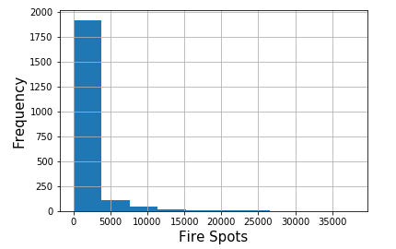
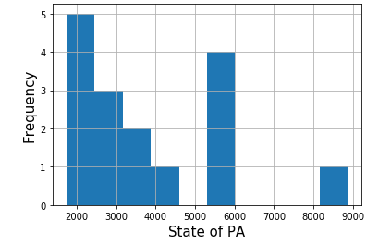
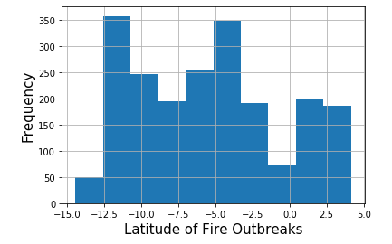
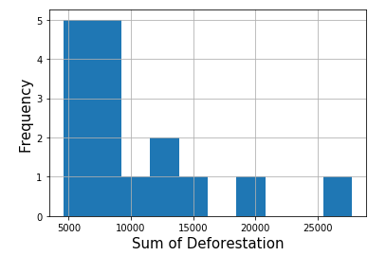
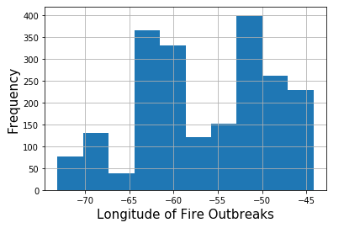
Histogram & Outliers
Outliers
Fire Spots in Amazon Fire Outbreak Data Set
Values begin to taper off as the number of fire outbreaks increase
Removal: It is important to understand the years that had an enormous amounts of fire out breaks but should not be included within the general data since it does not occur often enough
Sum of Deforestation and State of PA in Deforestation Data Set
Values begin to taper off in the higher numbers for amount of desforestation in the state and overall
Removal: Like before, with keeping all the information together it should be exlcuded, but it is important to note that it does occur

Slide 6
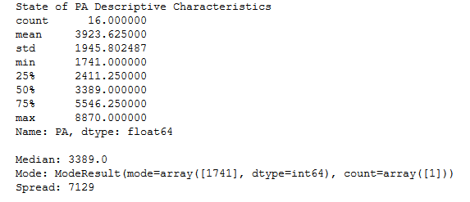
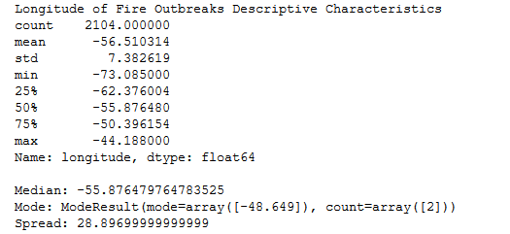
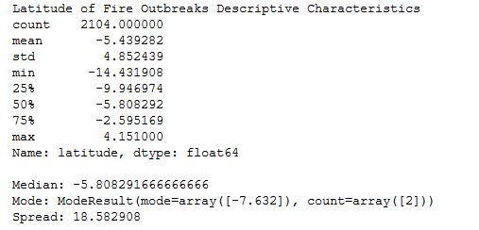
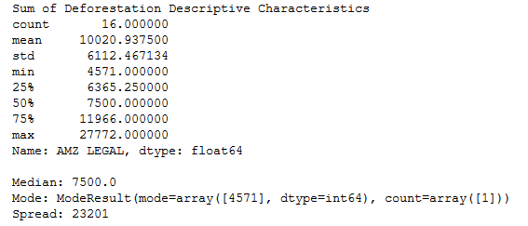
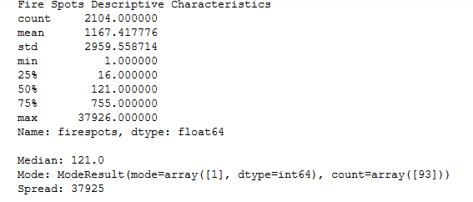
Descriptive Characteristics
Summary of descriptive characteristics including median, mode, and spread

Slide 7
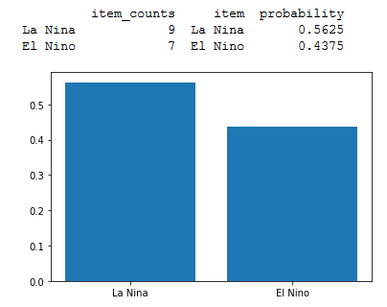
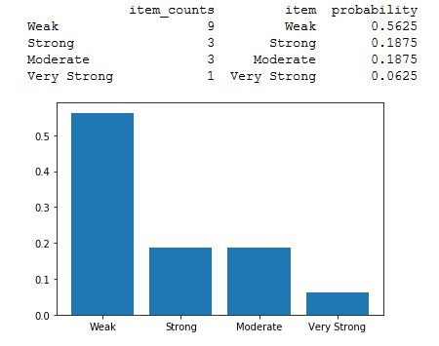
Probability Mass Function
Weather Phenomenon Severity
Weather Phenomenon El Nino and La Nina

Slide 8
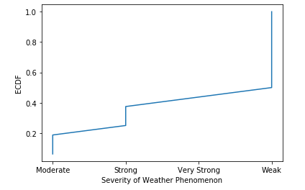
Cumulative Distribution Function
ECDF of Severity of the Weather Phenomenon Data Set
50% of occurrences are a weak storm
45% of occurrences are a very strong storm
35% of occurrences are a strong storm
20% of occurrences are a moderate storm
By determining the likelihood of the severity of the storms, I can then look back towards the years of the fire outbreaks and the storms to determine if there were more outbreaks and which phenomenon it was that year

Slide 9
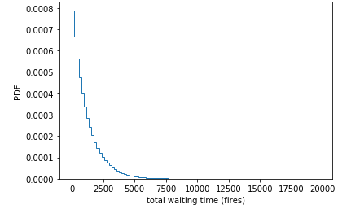
Exponential Distribution
With fire outbreaks, we can see the time it takes for a fire spot to occur in any of the several states is not long and occur at a rate that is almost continuous

Slide 10
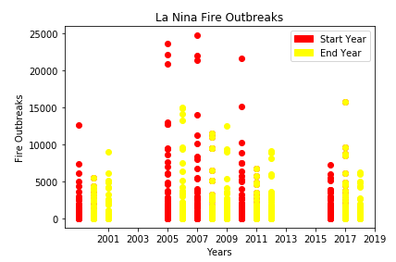
Correlation and Causation
Scatter Plot of fire Spots the start year and the end year

Slide 11


Correlation and Causation
Correlation and Covariance of fire spots for the start year of La Nina
Weak negative relationship
Correlation
Covariance
Start Year
Fire Spots
Start Year
Fire Spots
Start Year
Start Year
Fire Spots
Fire Spots

Slide 12


Correlation and Causation
Correlation and Covariance of fire spots for the end year of La Nina
Weak negative relationship
Correlation
Covariance
End Year
Fire Spots
End Year
Fire Spots
End Year
End Year
Fire Spots
Fire Spots

Slide 13

Hypothesis Test – Difference of Means
T-Value: 0.333
Indicates that the two groups(fire spots in start year & fire spots in end year) are similar
P-Value: 0.741
Indicates that these occurrences happened by chance and could not easily be reproduced

Slide 14
Linear Regression Analysis
Dependent variable: Years that La Nina started
Explanatory variable: Fire out breaks during the years that La Nina started
Prediction for years 2020 – 2025 of fire outbreaks based on model:
2020 - 1083
2021 - 1079
2022 - 1075
2023 - 1072
2024 - 1068
2025 - 1064

Slide 15
Conclusion
La Nina does have a strong correlation for fire outbreaks in the amazon
Even when the severity of the storm was the highest, the fire outbreaks were much on the higher side
Based on the model:
Fire outbreaks from the storms will continue with the possibility of increasing

